Slide 1
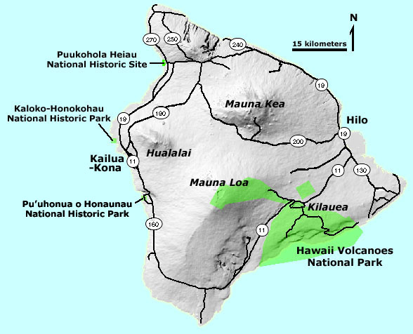
Notes:
Hawaii Volcanoes National Park incorporates much of Kilauea and the summit area of Mauna Loa. Our study now will focus on the features and recent eruption history of these two active volcanoes.

Slide 2
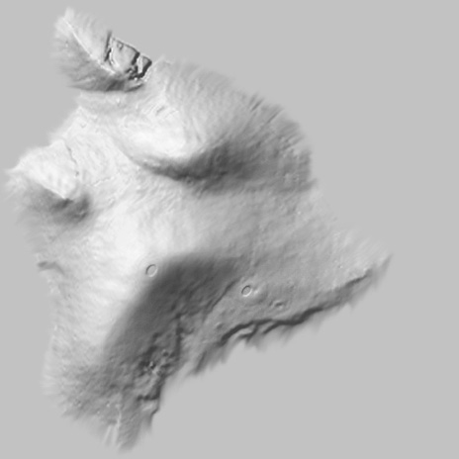
Mauna Loa
Kilauea
Notes:
Although Mauna Loa is far larger than Kilauea, the two shield volcanoes share similar structure.

Slide 3
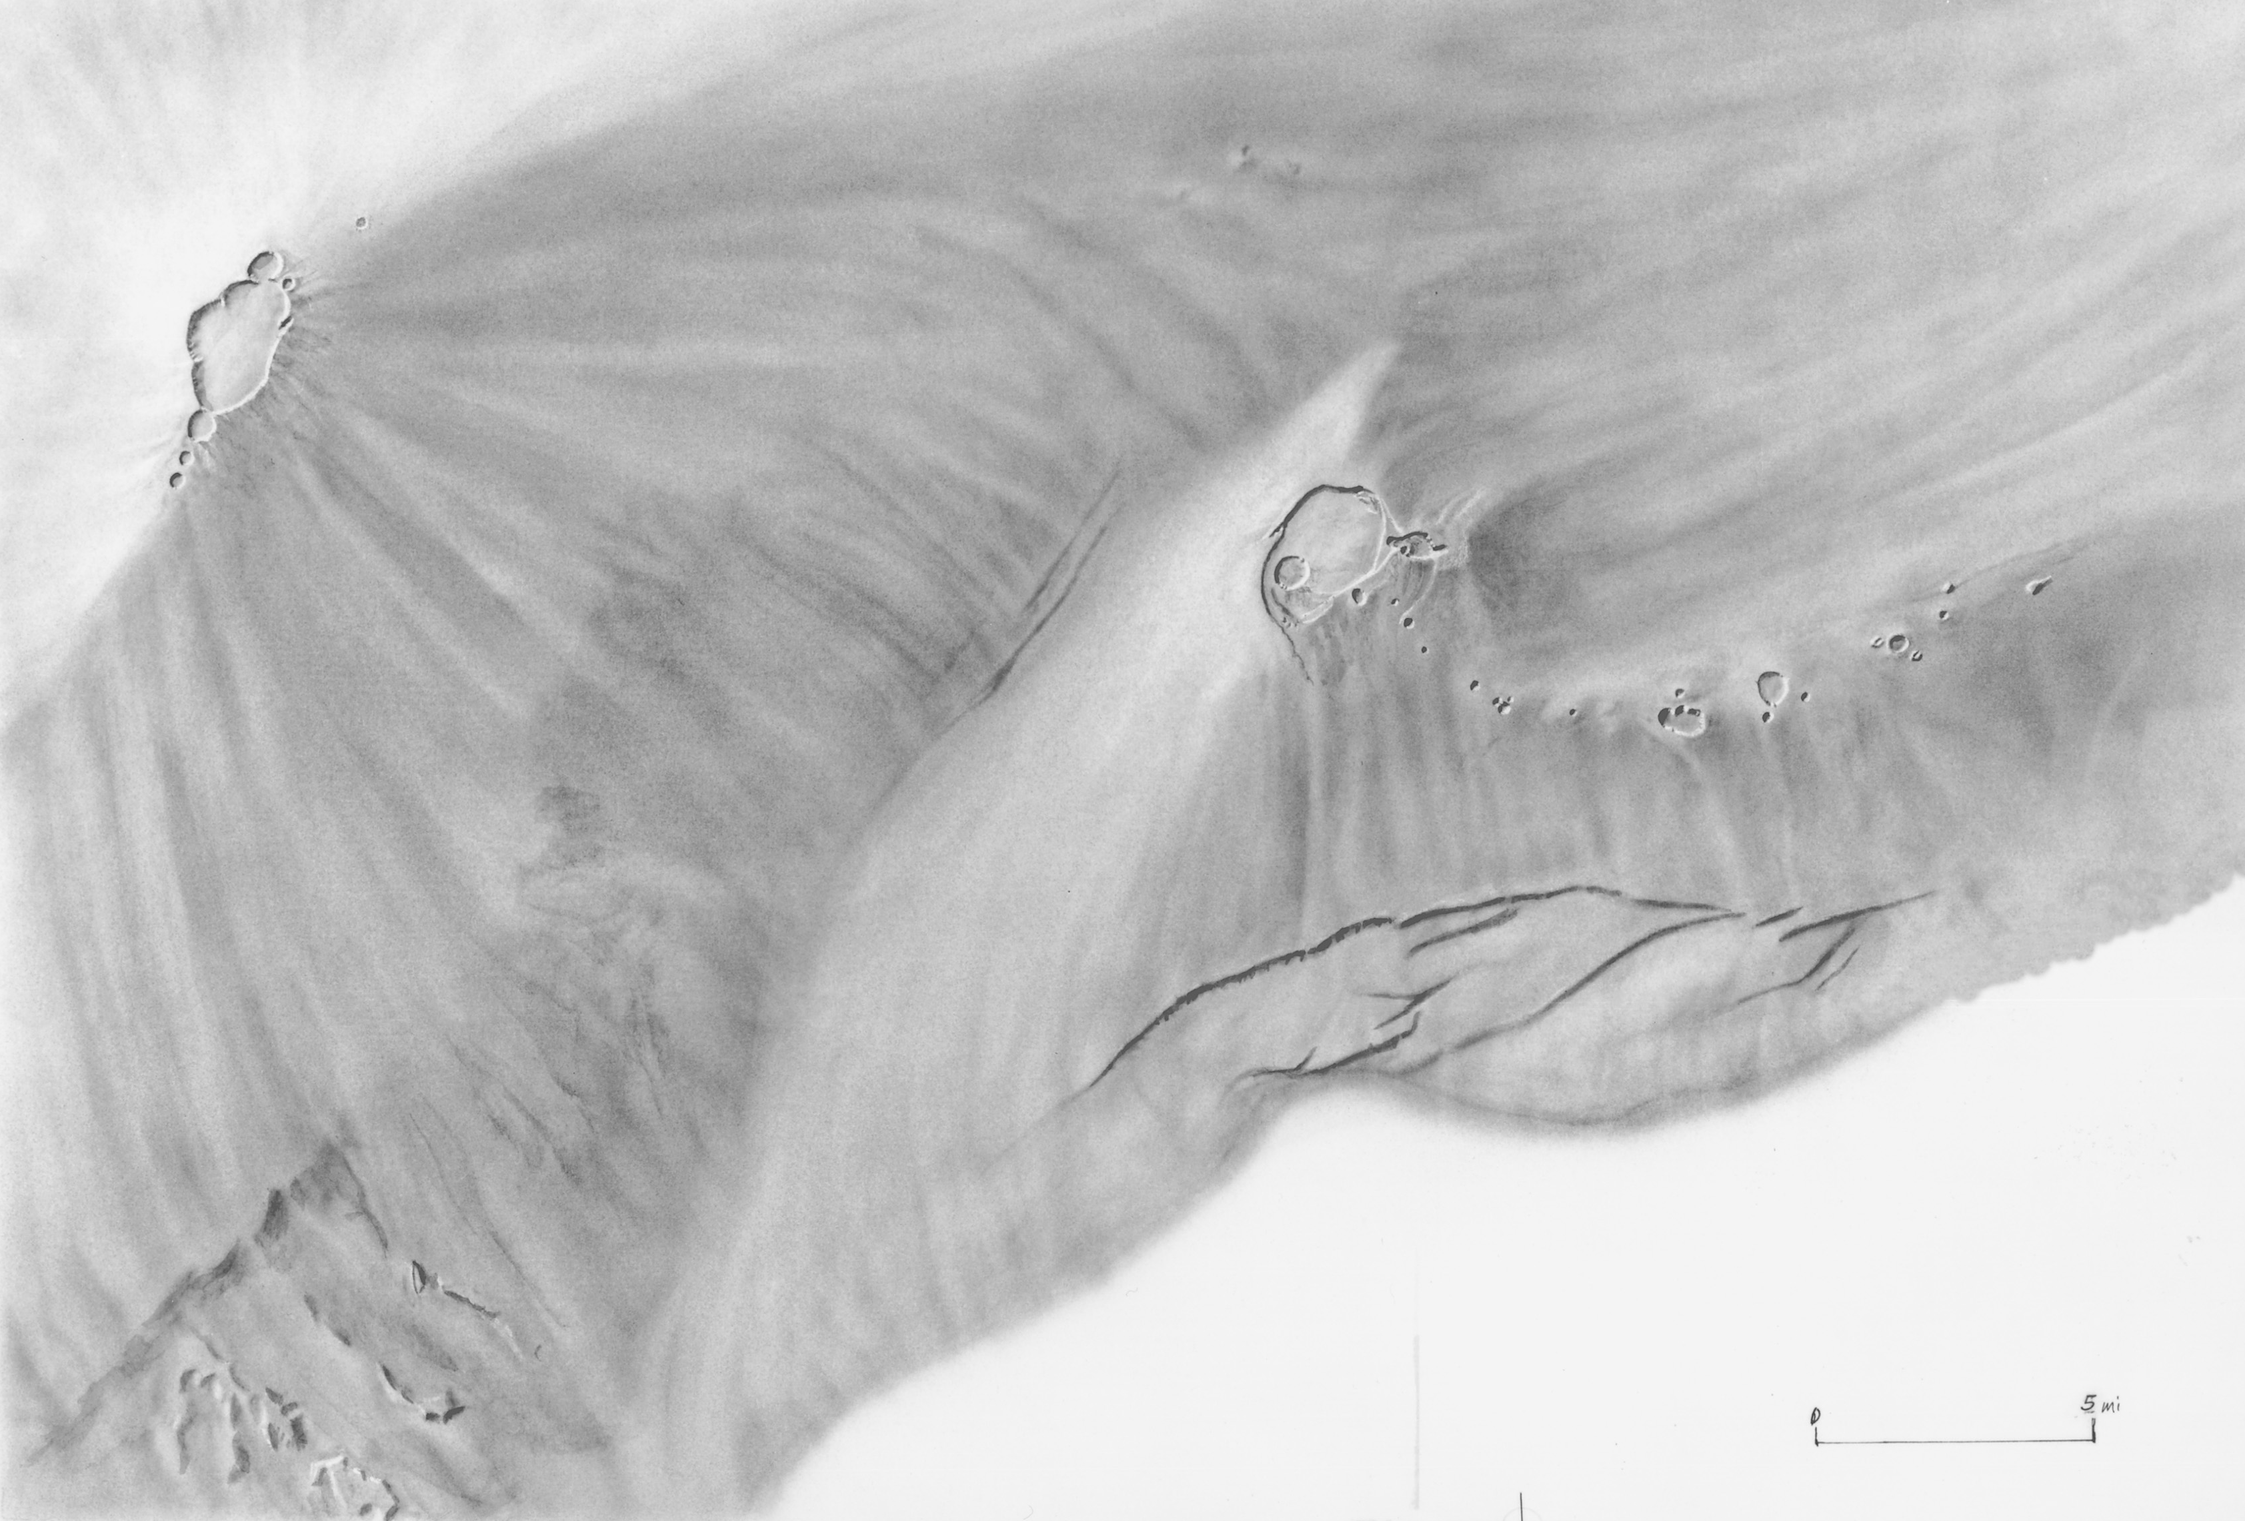
Mauna Loa
Kilauea
Notes:
Summit calderas lie at the top of both, …

Slide 4
Northeast Rift Zone
Southwest Rift Zone
East Rift Zone
Southwest Rift Zone
Notes:
… and rifts extend down the broad ridges that extend down from either side of the caldera. Both volcanoes have only two well developed rifts rather than the three equally-spaced rifts predicted in the idealized shield model. That’s because Mauna Loa buttresses Kilauea …

Slide 5
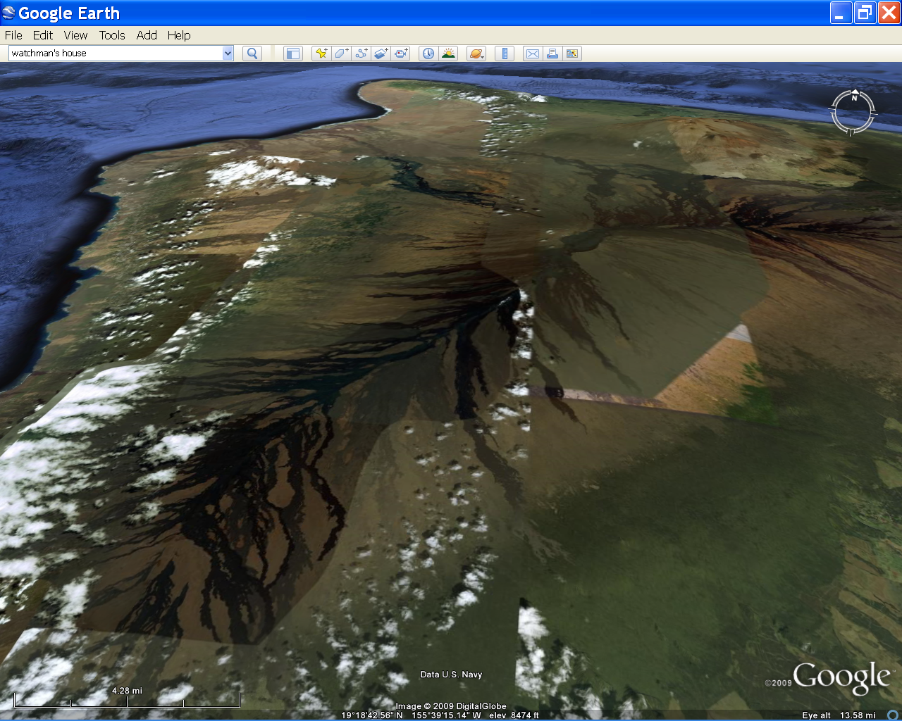
Hualalai
Mauna Loa
Notes:
… and Hualalai buttresses Mauna Loa. Since 1843 Mauna Loa has erupted 33 times …

Slide 6
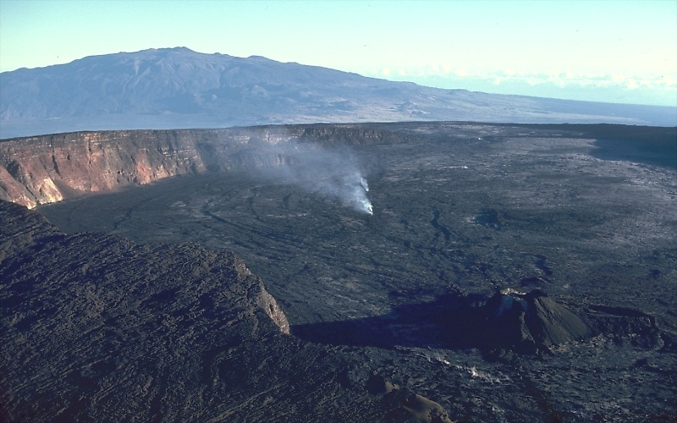
Caldera atop Mauna Loa, 1977
Notes:
… some of these from the summit caldera, …

Slide 7
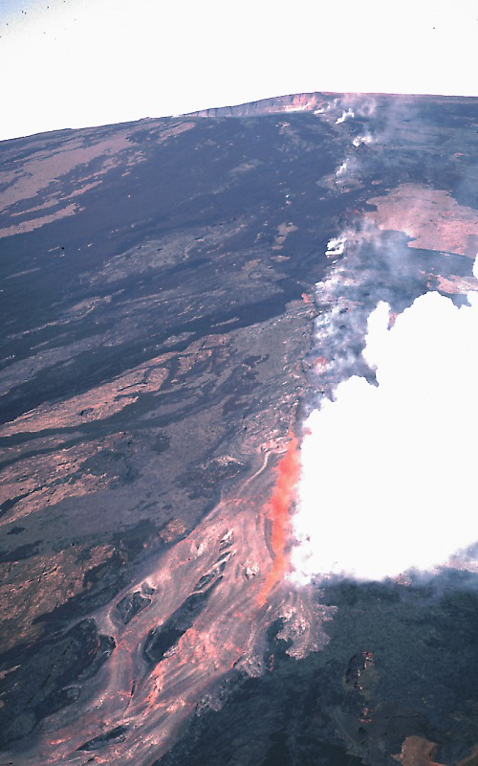
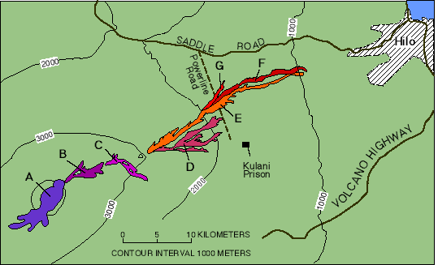
Mauna Loa Northeast Rift 1984
Notes:
… but more frequently from the flanking rifts. Mauna Loa has been unusually quite since its last eruption in 1984, which began at the summit, but quickly migrated down the southwest and northeast rift zones. Most of the lava erupted from fissures along the northeast rift and for a time threatened Hilo, ….

Slide 8
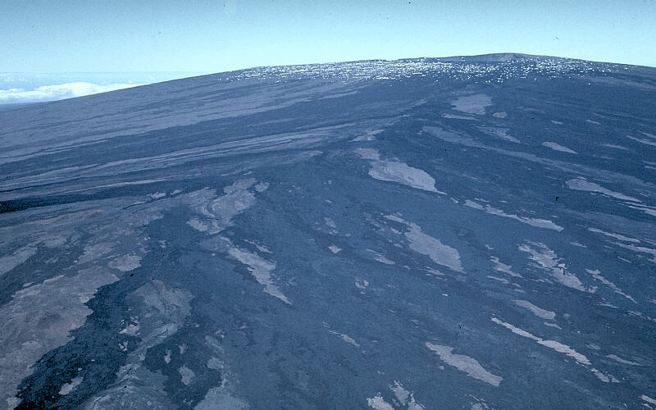
Northeast rift zone of Mauna Loa
Notes:
… but the gentle slopes and relatively high viscosity of the lava in this particular eruption kept most of the lava from flowing more than few kilometers away from the vents.

Slide 9
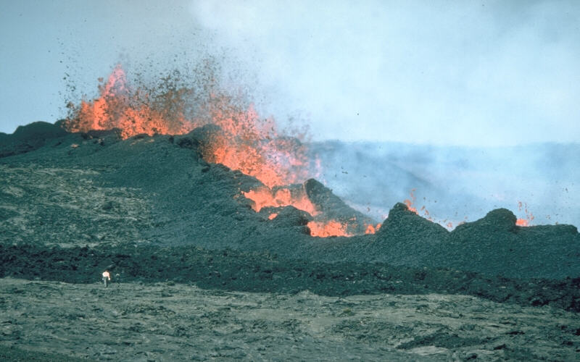
Spatter ramparts Mauna Loa 3/26/84
Notes:
The relatively high viscosity of the lava was due in part to its relative coolness and the vigorous lava fountains that occurred along the fissures. Fountaining not only helps cool the lava, but it drives off dissolved gases and the associated agitation leads to the formation of a thick, blocky form of basaltic lava know as aa. We will explain the formation of aa lava in greater detail later, but for now, note how the semisolid lava, known as spatter, collects around the fountain. Note person for scale in lower left. Lava fountains that erupt from an elongate fissure will build broad embankments of spatter, called spatter ramparts, along both sides of the fissure. The spatter commonly sticks together, or agglutinates, when it lands and is buried by later spatter. In contrast to these low linear fortifications, spatter cones are more circular and cone shaped--the only real distinction between the two structures is their shape.

Slide 10
Mauna Loa
Kilauea
Notes:
Kilauea is probably linked to the same magma source as Mauna Loa, because eruptions tend to alternate between the two volcanoes and rarely take place simultaneously at both. The pattern is well-documented for historical eruptions and the fact that Kilauea has been almost continuously erupting since 1983, while Mauna Loa has not erupted since 1984, is a particularly good example of the mutual eruptive exclusivity of these volcanoes. The recent history is not, however, representative of eruption frequency, because over the last 150 years eruption periodicity averages something more like every 2 to 3-years.

Slide 11
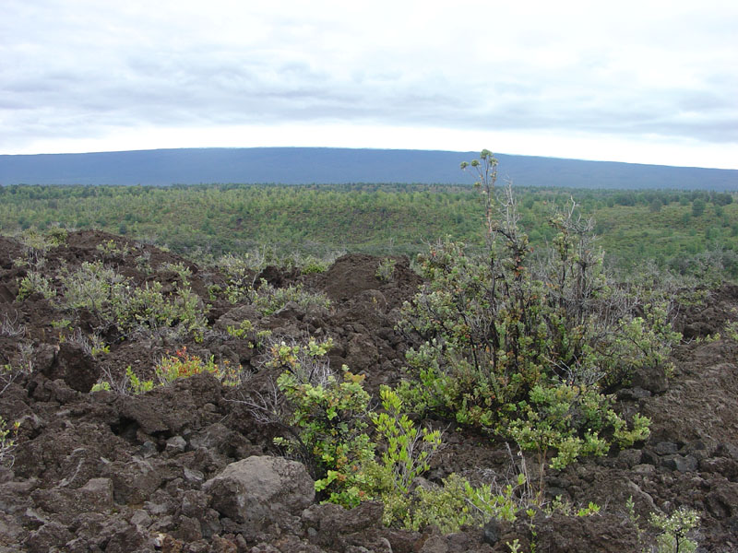
A Typical Shield Eruption
Notes:
Certain general patterns emerge in the frequent eruptions of Mauna Kea and Kilauea from which a generalized model for a typical shield volcano eruption can be developed.

Slide 12
Stage 1 – Reservoir Filling
Notes:
The first stage in a new eruption is the filling of the magma reservoir inside of the shield.

Slide 13
Notes:
As magma works its way from the mantle into the interior of the shield volcano measurable swelling of the volcano’s surface occurs …

Slide 14
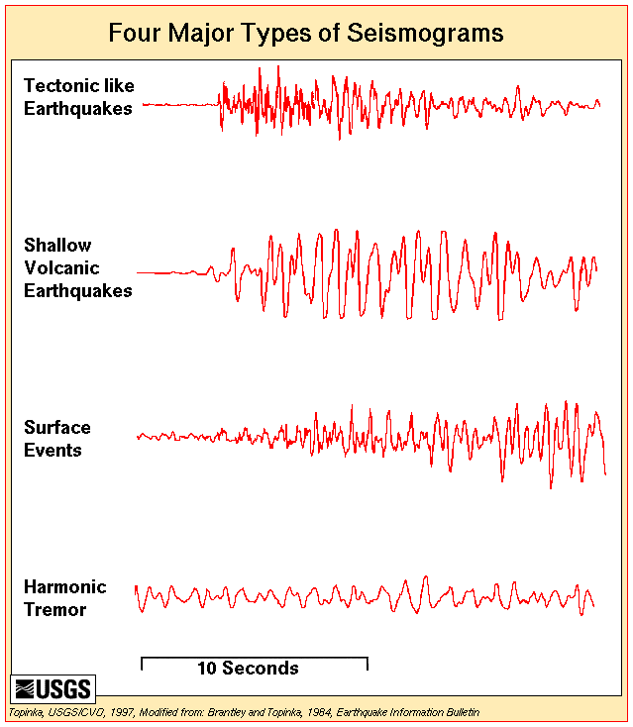
Stage 1
Notes:
… accompanied by prolonged rhythmic seismic activity known as harmonic tremors. The phenomenon is believed to be the result of vibrations produced as magma flows through conduits – similar to that produced when fluid moves energetically through a pipe or fire hose.

Slide 15
Stage 2
Notes:
In stage 2 shallow, short period earthquakes often occur close to where the magma is about to break out. These earthquakes are caused by rock cracking due the stress of rising magma and are frequently associated with changes in the concentration of CO2, CO and other gases from nearby fumaroles. These precursors events indicate that an eruption will occur within a few days.

Slide 16
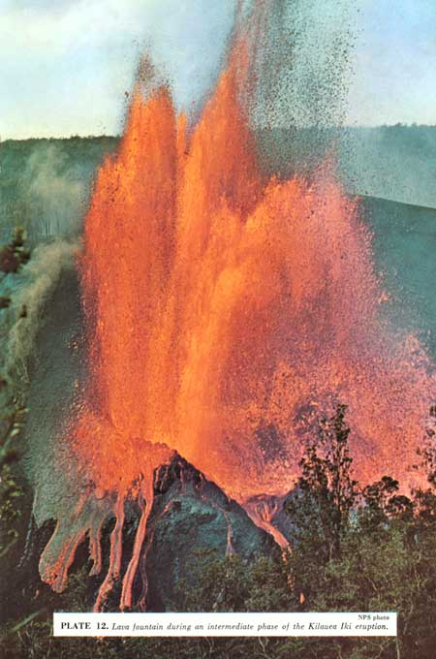
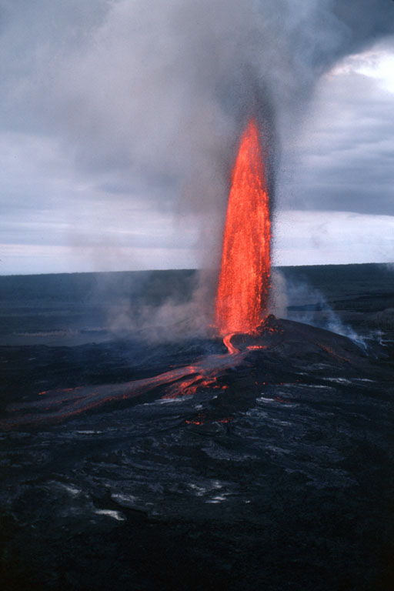
Stage 3: Initial Outburst
Kilauea Iki, 1959
Pu’u O’o, 1983
Notes:
The initial outburst is usually a spectacular lava fountain such as that of Kilauea Iki in 1959 and Pu’u O’o in 1983.

Slide 17
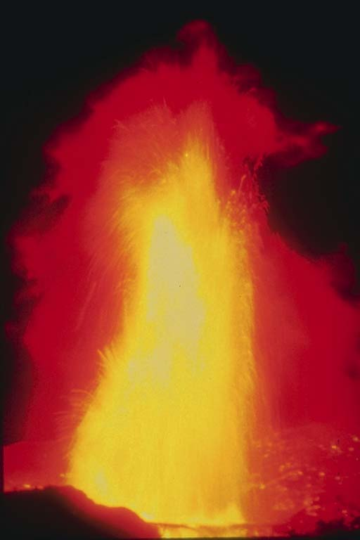
Kilauea Iki, 1959
Notes:
At 1900’, Kilauea Iki holds the record for the highest lava fountain on record.

Slide 18
Kilauea Caldera
1959
Kilauea Iki Crater
Notes:
The spectacular 1959 eruption of Kilauea Iki (or little Kilauea) touched off a bit of volcano mania in popular culture of the day, which by association spilled out to Hawaii in general (note the Luau-version of Elvis). The eruption cycle associated with Kilauea Iki is often cited as the textbook example of how a shield eruption “should” behave.

Slide 19
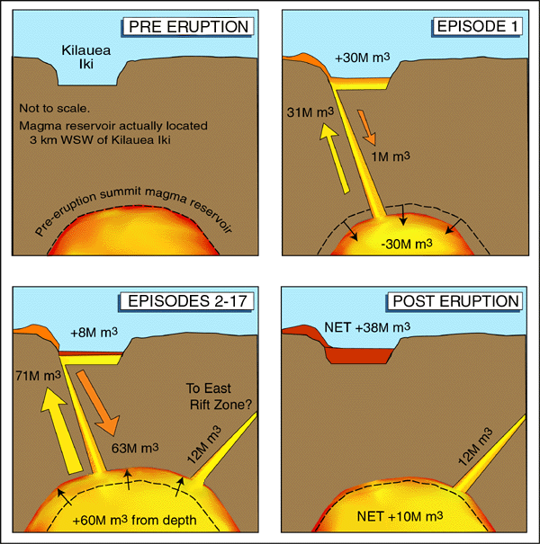
Eruption of Kilauea Iki
Notes:
During the eruption of Kilauea Iki, about 31 million cubic meters of magma moved from the summit magma reservoir into Kilauea Ike Crater, of which about 1 million cubic meters drained back. Then a surge of some 60 million cubic meters of new magma from depth swelled the reservoir sending some 71 cubic meters of magma back into the crater (most of which drained back into the reservoir) and presumably opening a magma conduit to the East Rift Zone. The eruption at Kilauea Iki ends as magma is drawn away from the reservoir via new eruptions from lower portions of the East Rift Zone.

Slide 20
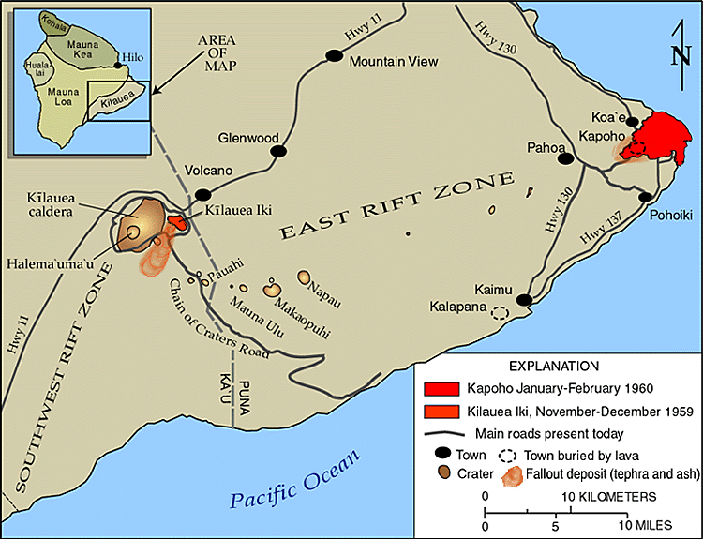
Notes:
That lower rift zone eruption happened some 40 km east of Kilauea Iki and destroyed the idyllic little community of Kapoho in 1960. Tiny earthquakes started to record at the seismograph in Pahoa, signaling that magma was breaking through rock and clearing a conduit to the surface.

Slide 21
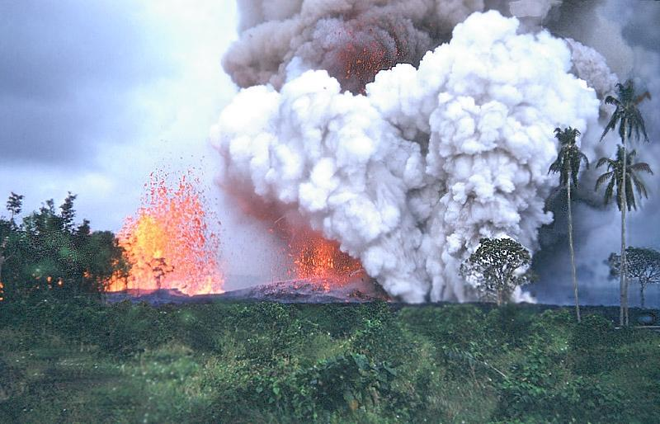
1960 Kapoho eruption
Notes:
Occurring low on Kilauea’s flanks and almost near sea level, the 1960 Kapoho eruption interacted with groundwater causing violent phreatic eruptions …

Slide 22
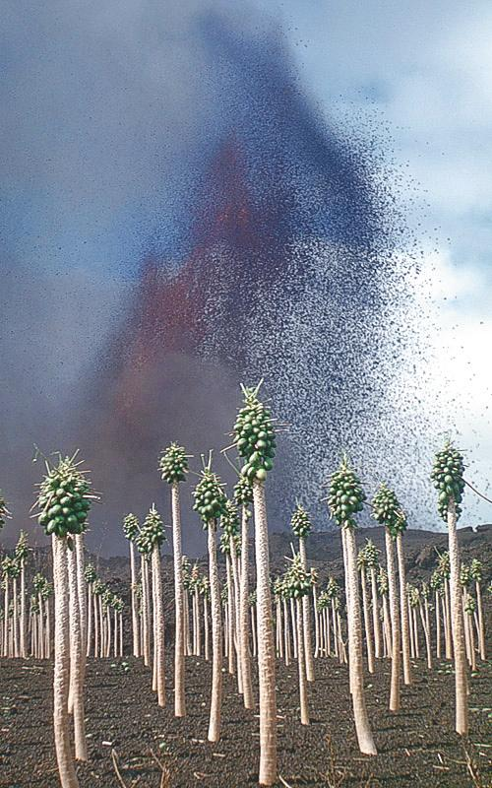
Notes:
and the production of unusually large quantities of ash – seen here defoliating a papaya orchard.

Slide 23
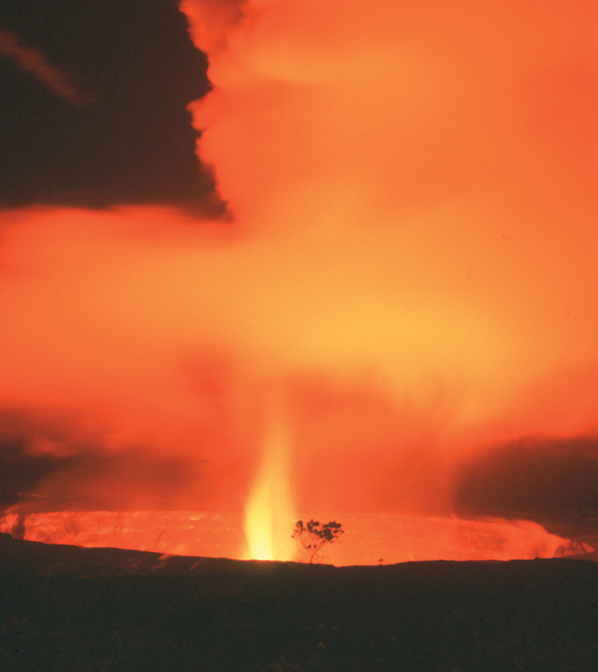
Halema‘uma‘u Crater (about 1967-68)
Notes:
Similar progressions from summit to flank eruptions have taken place at Halema'uma'u …

Slide 24
Kilauea Caldera
1848-1982
Halema’uma’u Crater
Notes:
… a particularly active crater which lies within Kilauea Caldera.

Slide 25
East Rift Zone
Southwest Rift Zone
Notes:
Eruptions often begin at Halema'uma'u and migrate down one or more of the flanking rift zones.

Slide 26
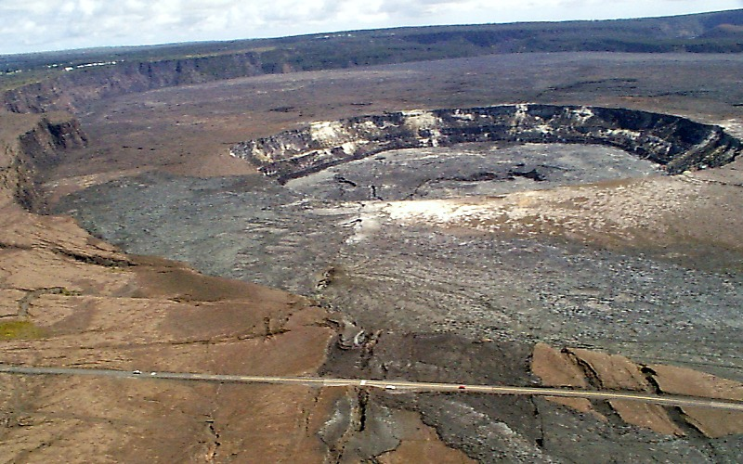
Kilauea Caldera
Halema’uma’u Crater
Southwest rift zone
Notes:
Notice the ground fractures associated with the southwest rift zone which extend from Halema`uma`u through the caldera rim to bottom center of image.

Slide 27
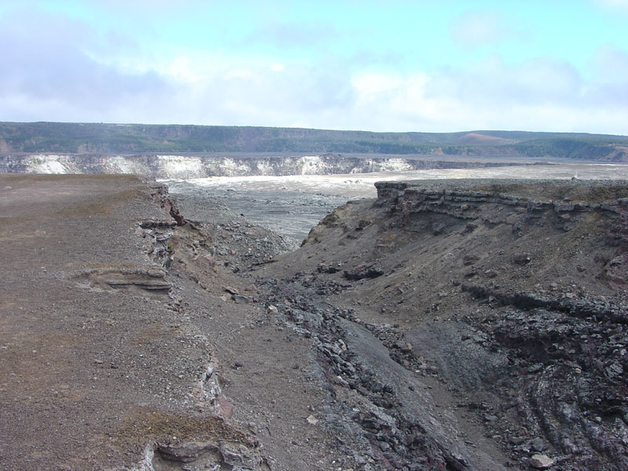
Southwest Rift Zone Fissure
Notes:
Tensional stress and energetic fountaining widens the cracks into fissures.

Slide 28
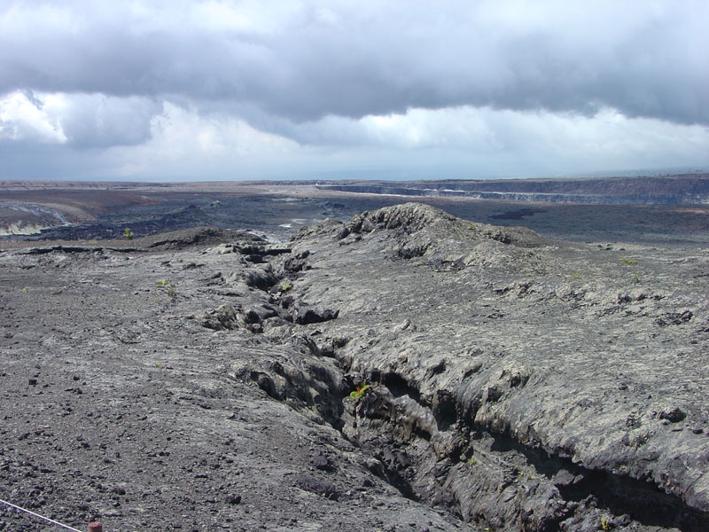
Location of 1974 fissure eruption
Notes:
As eruptions migrate to lower portions of the rift, …

Slide 29
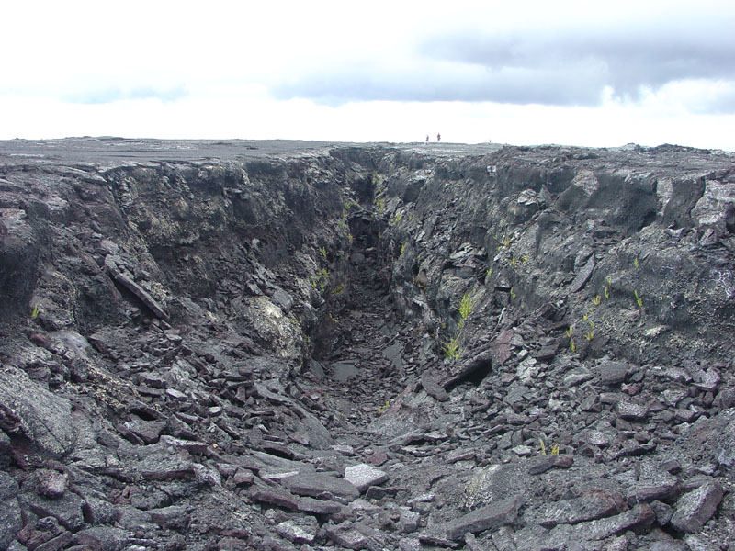
Southwest Rift Zone Fissure
Notes:
… magma is drained away from higher areas, leaving gaping chasms were magma has sank back into the rift.

Slide 30
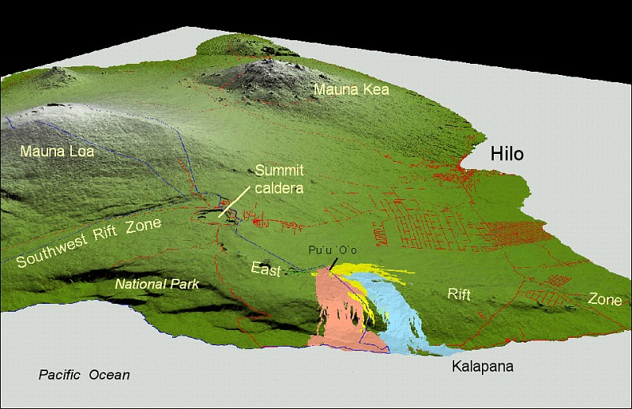
Pu`u `Ō `ō
Kupaianaha
Notes:
Active since 1983, the Pu`u `Ō `ō - Kupaianaha eruption of Kīlauea, ranks as the most voluminous outpouring of lava on the volcano's east rift zone in the past five centuries. The long-lived eruption illustrates stages 4 and 5 of a model shield eruption – vent localization and vent shift.

Slide 31
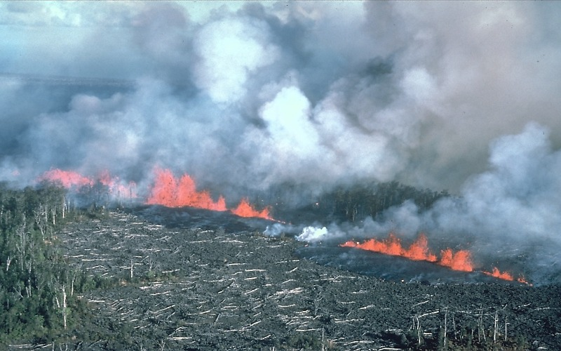
1st week of Pu’u O’o – Kupainaha eruptions. Fissures erupt lava (1/5/83).
Notes:
The eruption began as intermittent fissure eruptions …

Slide 32
East Rift Zone
Notes:
… along the middle section of Kilauea’s East Rift Zone …

Slide 33
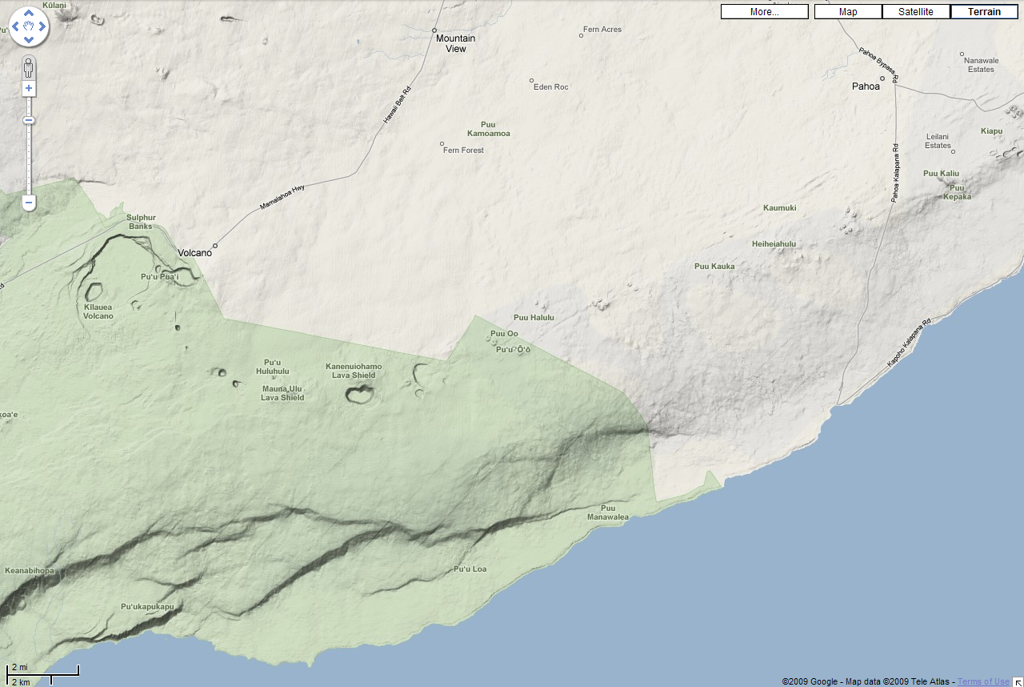
Kalalua
Napau Crater
Notes:
… from Napau Crater to Kalalua.

Slide 34
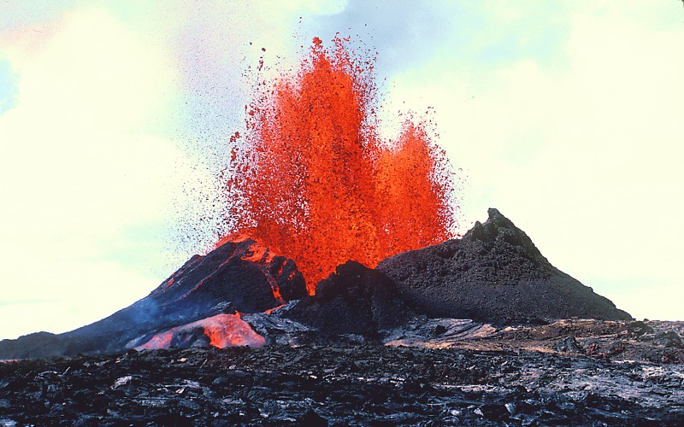
9/6/83 Pu’u O’o during eruptive episode 8
Stage 4: Vent Localization
Notes:
Six months later, a primary conduit to the surface became established and activity localized at the Pu`u `O`o vent.

Slide 35
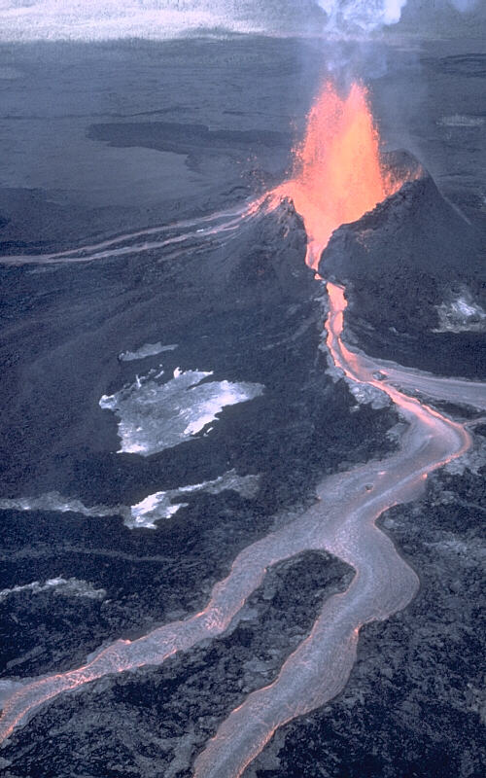
Effusive eruption. Series of a’a lava channels and flows
1/31/84
Notes:
Activity remained at Pu’u O’o for about three years, varying from relatively mild effusive eruptions …

Slide 36
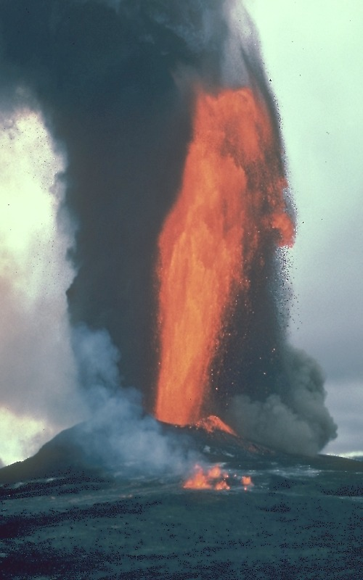
450 m high lava fountain Pu’u’ O’o’ 1984
Notes:
… to spectacular lava fountains. Such fountains build cinder and spatter cones around the vent while relieving gas pressure on the magma. When most of the gas has been released, magma may not be able to rise to the top of the now-tall cone to spill out, and so may leak out from a lower portion of the rift.

Slide 37
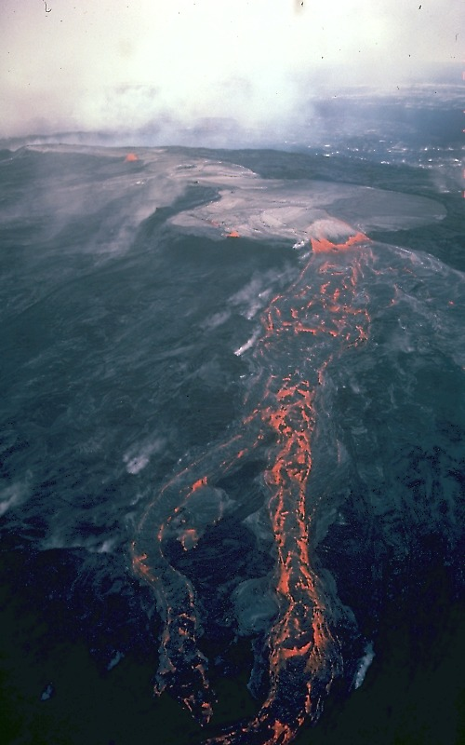
Kupaianaha, 1986
Stage 5: Vent Shift
Notes:
This causes the vent to shift to the lower area - as it did when the Pu’u O’o eruption shifted to Kupaianaha.

Slide 38
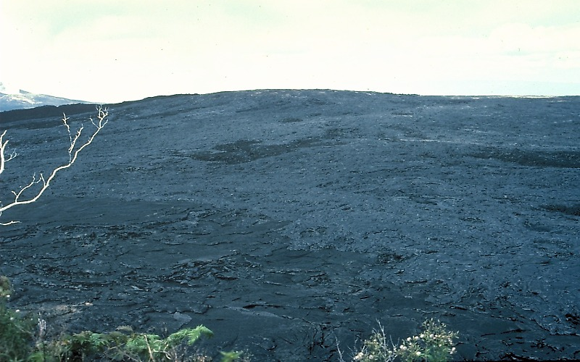
The Kupaianaha shield, 1987
Notes:
Lava may accumulate around the new vent to form a small shield, which by up growth makes it progressively more difficult for magma to reach the surface of the new vent. Thus the vent may shift again as magma finds an easier route to the surface. That may be further down the rift, but for Kupaianaha, …

Slide 39
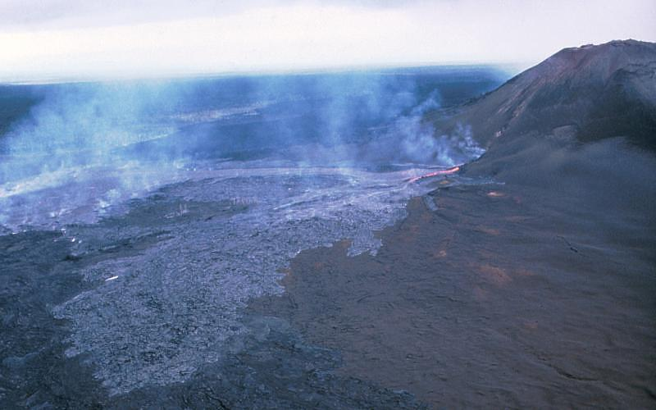
Vent shifts back to Pu’u O’o, 1992
Pu’u O’o
Notes:
… the vent shifted up rift to the southwest flank of Pu’u O’o,

Slide 40
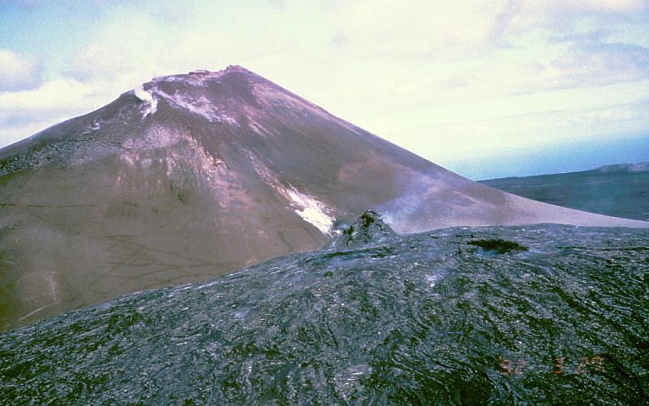
Pu’u O’o
shield
Notes:
… where another shield was built. Again magma found an easier route to the surface ….

Slide 41
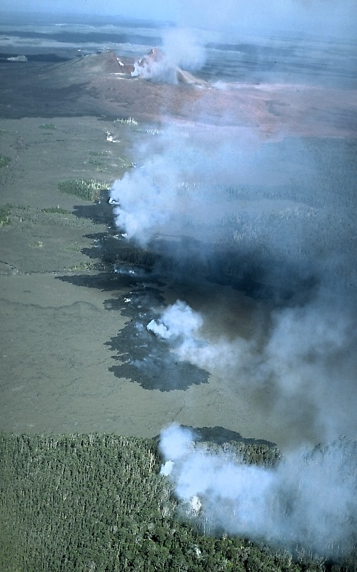
Pu’u O’o
Napau Crater
Notes:
… as the vent shifted once again – now back to Napau Crater where the original rift eruptions began. As magma drained from Pu’u O’o crater into the newly activated conduits beneath Napau Crater, Pu’u O’o, now without the buoyant support of a magma lake, collapsed into its crater. The eruptions along Napau Crater were short lived, …

Slide 42
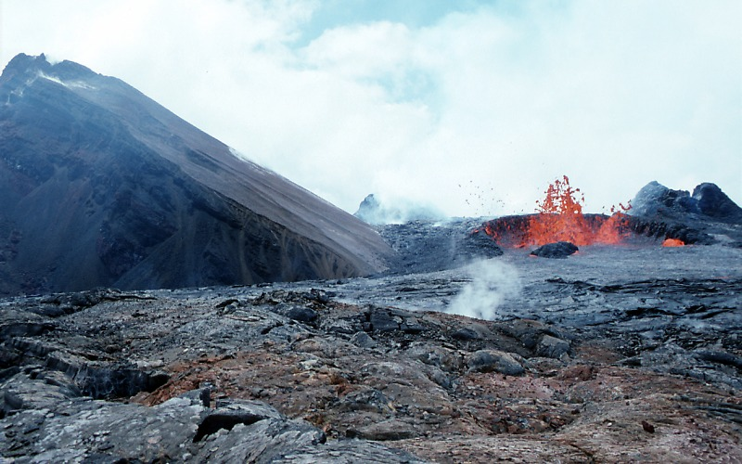
Pu`u `O`o, 1997
Notes:
… and once again activity shifted back to the flanks of Pu’u O’o, where as of this writing (2009), activity has mostly remained. The eruption at Pu’u O’o is the longest lasting at Kilauea in the past 200 years, …

Slide 43
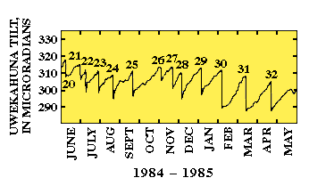
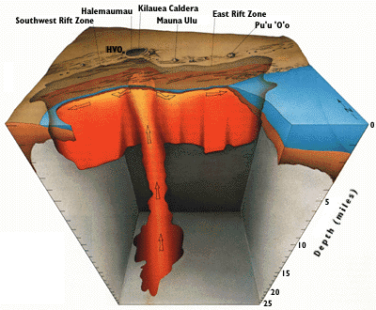
Stage 6:
Final Deflation
Notes:
… but eventually it will come to an end and as it does, the entire volcano will deflate to its pre-eruption state. To be clear, inflation and deflation take place at different places and times as well as different time scales.

Slide 44
Tilt meter record at Kilauea Caldera
initial inflation
Stages 1,2 & 3:
Initial inflation, shallow earthquakes & initial outburst
Notes:
Eruptions often begin at the summit with the initial inflation of the volcano, but usually shift to one of the two rift zones that radiate that radiate from the summit.

Slide 45
Temporary summit deflation
Stages 4 & 5:
Vent localization & vent shift
Notes:
Summit deflation occurs during intrusion of magma in the rift zone or during a flank eruptions.

Slide 46
Temporary summit inflation
Stages 4 & 5:
Vent localization & vent shift
Notes:
When the flank eruption or intrusion ends, summit re-inflation proceeds as magma continues to rise from below. The volcano is considered to be in an eruptive state as long as inflation persists, even if no lava is flowing at the surface. More than 50 such inflation/deflation cycles have been recorded at the rim of Kilauea Caldera during the various flank eruptions in and around Pu’u O’o.

Slide 47
Final deflation
Stage 6:
Final Deflation
Supply of new magma ends
Notes:
The eruption “officially” ends when the volcano deflates to its original shape.

Slide 48
Volcanic Features
Vent collapse and/or erosion
Pyroclastic eruptions
Lava flows and related features
Notes:
As the various phases of a shield eruption unfold, a diverse spectrum of landforms are created. First let’s have a look at those created by collapse and/or erosion around volcanic vents.

Slide 49
caldera
Notes:
The largest of these is the 2-mile wide summit caldera which forms by gravitational collapse along ring faults into the main magma storage reservoir below.

Slide 50
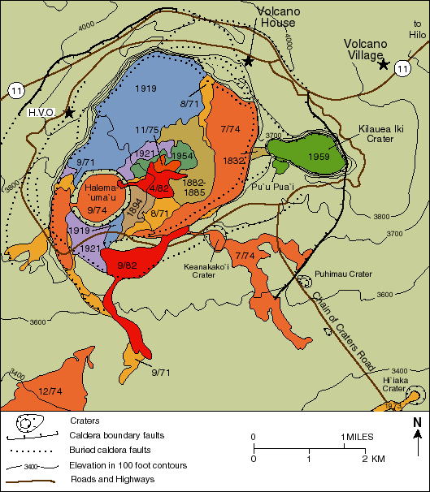
Notes:
The floor of the caldera is almost completely covered by lava flows from numerous eruptive episodes, …

Slide 51
pit crater
Halema’ uma’ u
Notes:
… most of which spilled from Halema`uma`u. Halema`uma`u is a half-mile-wide “pit crater” formed when the lava lake inside it drained away and a series of steam-driven explosions and rock falls doubled the size of the crater to about its present dimension. The collapse in 1924 lowered the floor of Halema`uma`u to a remarkable depth of 390 m, but eruptions in the next 10 years filled the crater to a depth of 150 m.

Slide 52
East Rift Zone
Southwest Rift Zone
Notes:
Several pit craters occur along the Kilauea’s East Rift Zone, …

Slide 53
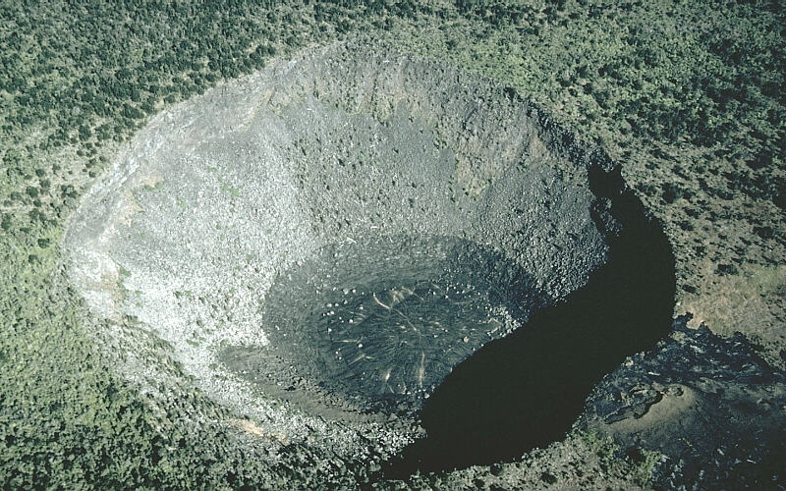
Hi`iaka pit crater on the East Rift Zone
Notes:
… such as Hi`iaka pit crater. The floor of the crater is covered by solidified lava that poured into the crater from the lower right (note black lava flow at crater rim). Pit craters are circular-shaped craters formed by the sinking or collapse of the ground. Fissures may erupt from the walls or base of a pit crater, but pit craters are not constructional features built by eruptions of lava or tephra. Pit craters may also partially fill with lava to form a lava lake. They are common along rift zones of shield volcanoes and thought to form as a consequence of the removal of support by withdrawal of underlying magma.

